Slide 1
MLOps

Slide 2
Abstract and learning objectives
In this workshop, you will learn how Trey Research can leverage Deep Learning technologies to scan through their vehicle specification documents to find compliance issues with new regulations, and manage the classification thru their web application. The entire process from model creation, application packaging, model deployment and application deployment needs to occur as one unified repeatable, pipeline.
At the end of this workshop, you will be better able to design and implement end-to-end solutions that fully operationalize deep learning models, inclusive of all application components that depend on the model.

Slide 3
Step 1: Review the customer case study
Outcome
Analyze your customer needs
Timeframe
15 minutes

Slide 4

Customer situation
Trey Research Inc. delivers innovative solutions for manufacturers.
They specialize in identifying and solving problems for manufacturers that can run the range from automating away mundane but time-intensive processes to delivering cutting edge approaches that provide new opportunities for their manufacturing clients.
Trey Research has decades specializing in data science and application development that until now were separate units.
They have seen the value created by the ad-hoc synergies between data science and app development, but they would like to unlock the greater, long term value as they formalize their approach by combining the two units into one, and follow one standardized process for operationalizing their innovations.

Slide 5


Customer situation
They would to define a process for operationalizing deep learning that encompasses all phases of the application life cycle along with model creation and deployment of a deep learning model.
Looking to leverage Deep Learning technologies with Natural Language Processing techniques to scan through vehicle specification documents to find compliance issues with new regulations.
The component descriptions (which are free form text) are entered and managed via a web application. This web application take new component descriptions entered by authorized technicians and labels the component as compliant or non-compliant based on the text.
For the PoC, they have exported all of their labeled component descriptions as flat files (CSV format).

Slide 6
Customer situation
Want to ensure the overall process they create enables them to update both the underlying model and the web app in one using a standardized approach.
Want to be able to monitor the model's performance after it is deployed so they can be proactive with performance issues. They believe they can accomplish most, if not all, of this using Azure Machine Learning but are wanting to be certain.
Would like to ensure that the process they establish is not littered with username and password credentials used to access the component used during build and release.

Slide 7
Customer needs
Want to understand the best practice process they should follow for end-to-end deployment of deep learning models.
Need a solution that addresses the management of the entire model lifecycle, inclusive of monitoring the model in production and being able re-train and re-deploy when a model needs updating.
A process that avoids checking credentials into source control.

Slide 8
Customer objections
We are not clear about the benefits that using ONNX might bring to our current scenario and future scenario.
It seems like data scientists deploy their models as web services from their own python scripts, where as our developers are accustomed to using Azure DevOps to deploy their web services. Can we really have one tool that provides us build and deployment pipelines irrespective of whether we are deploying a model or web application code?
Obviously, we can't just have new models automatically deployed into production. What kind of safeguards can we put in place?

Slide 9
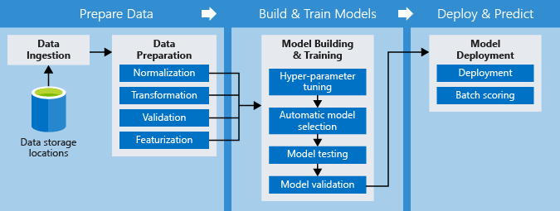
Common scenarios

Slide 10
Step 2: Design the solution
Outcome
Design a solution and prepare to present the solution to the target customer audience in a 15-minute chalk-talk format.
Timeframe
60 minutes
Business needs (10 minutes) | Respond to questions outlined in your guide and list the answers on a flipchart
Design (35 minutes) | Design a solution for as many of the stated requirements as time allows. Show the solution on a flipchart
Prepare (15 minutes) | Identify any customer needs that are not addressed with the proposed solution Identify the benefits of your solution Determine how you will respond to the customer’s objections Prepare for a 15-minute presentation to the customer

Slide 11
Step 3: Present the solution
Outcome
Present a solution to the target customer in a 15-minute chalk-talk format
Timeframe
30 minutes (15 minutes for each team to present and receive feedback)
Directions
Pair with another table
One table is the Microsoft team and the other table is the customer
The Microsoft team presents their proposed solution to the customer
The customer asks one of the objections from the list of objections in the case study
The Microsoft team responds to the objection
The customer team gives feedback to the Microsoft team

Slide 12
Wrap-up
Outcome
Identify the preferred solution for the case study
Identify solutions designed by other teams
Timeframe
15 minutes

Slide 13
Preferred target audience
Francine Fischer, CIO of Trey Research
The primary audience is the business decision makers and technology decision makers. From the case study scenario, this would include the Director of Analytics. Usually we talk to the infrastructure managers, who report to the chief information officers (CIOs), or to application sponsors (like a vice president [VP] line of business [LOB], or chief marketing officer [CMO]), or to those that represent the business unit IT or developers that report to application sponsors.

Slide 14
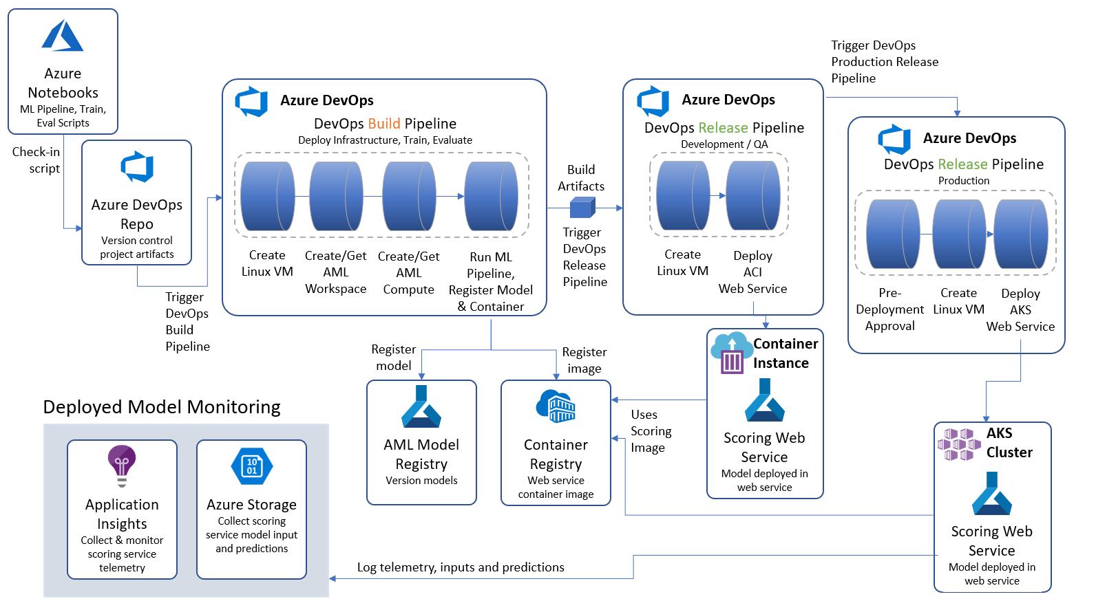
Preferred solution
Notes:
The overall approach is to orchestrate continuous integration and continuous delivery Azure Pipelines from Azure DevOps. These pipelines are triggered by changes to artifacts that describe a machine learning pipeline, that is created with the Azure Machine Learning SDK. For example, checking in a change to the model training script executes the Azure Pipelines Build Pipeline, which trains the model and creates the container image. Then this triggers an Azure Pipelines Release pipeline that deploys the model as a web service, by using the Docker image that was created in the Build pipeline. Once in production, the scoring web service is monitored using a combination of Application Insights and Azure Storage.

Slide 15
Preferred solution
Component Classification
1. What is the general pipeline for approaching the training of text analytic models such as this? What are the general steps you need to take to prepare the text data for performing tasks like classification?
The core task in natural language processing (NLP) text pipelines is data preparation to express the textual data as numeric vectors by using word embeddings.
The general pipeline begins by pre-processing or normalizing the text.
The output of this phase is typically a multi-dimensional array consisting of an array of documents, each having an array of sentences, with each sentence having its own array of words.
The next step is feature extraction, which creates a numeric representation of the textual documents. During feature extraction, a "vocabulary" of unique words is identified, and each word becomes a column in the output. Each row represents a document.
The value in each cell is typically a measure of the relative importance of that word in the document, where if a word from the vocabulary does not appear, then that cell has a zero value in that column. This approach enables machine learning algorithms, which operate against arrays of numbers, to also operate against text. Deep learning algorithms operate on tensors, which are also vectors (or arrays of numbers), so this approach is also valid for preparing text for use with a deep learning algorithm.

Slide 16
Preferred solution
Component Classification
2. Provided that Trey wants to build the PoC using Azure Machine Learning, what is the first item they would want to deploy in Azure?
They would begin by deploying an Azure Machine Learning workspace.
3. Within the above deployed item, what component would they use to orchestrate the various **machine learning** phases (specifically data access, model training and model evaluation)? Be specific about which programming language and framework or SDK they would use.
Trey should consider building a machine learning pipeline. They can author these pipelines in Python using the Azure Machine Learning SDK.
4. Where would they author any scripts?
For the machine learning phases listed, they could author the machine learning pipeline in Azure Notebooks, which provides a free-to-use notebook environment that can leverage the scalable compute provided by Azure and Azure Machine Learning Compute.

Slide 17
Preferred solution
Component Classification
5. Where should Trey upload the component compliance data?
Each Azure Machine Learning Workspace has a default datastore (and you can register additional datastores).
By default, both Azure Files and Azure Blob storage are attached to the workspace and you can use either one. For the PoC, Trey could use the blob storage associated with the Workspace in Azure Blob Storage as the location to upload the component description CSV files.
For production down the road, they might consider setting up a dedicated Azure Blob storage account that stand-alone from the workspace and could be a central data lake for all their documents, supporting analytics outside of the workspace.

Slide 18
Preferred solution
Component Classification
6. Describe at a high level the objects involved in the scripted pipeline you would create for training the compliance classification model using Azure Machine Learning.
Data Store
Trey would create a Data Reference to the datastore that contains the component text files. They would also script creating or retrieving an existing Azure Machine Learning Compute (which would provide the computing cluster that would execute the training script).

Slide 19
Preferred solution
Component Classification
6. Describe at a high level the objects involved in the scripted pipeline you would create for training the compliance classification model using Azure Machine Learning.
Pipeline Definition Script
Next, in a script (the pipeline definition script) they would define pipeline steps in a pipeline object and then submit the pipeline object to run it. In the simplest case they could define a Pipeline with two PythonScriptSteps:
- The first PythonScriptStep would reference a python script that performs the actual training of the model, saves the trained model to disk and then registers the model with the model registry associated with the Azure Machine Learning workspace.
The second PythonScriptStep references a separate Python script that would evaluate the model's performance and logs the results.
Optionally, this PythonScriptStep could automatically deploy the model as a web service if it exceeded the performance of the previously deployed model. To accomplish this, the evaluation script would refer to a third Python script, the scoring script, that defines the web service logic. This scoring script would be packaged along with any dependencies and the trained model as a Docker image and registered in the Azure Container Registry that is deployed with the Azure Machine Learning workspace.
Both of the aforementioned scripts would make use of the Azure Machine Learning Python SDK.
The pipeline definition script creates an Azure Machine Learning Experiment in the workspace, and submits the pipeline object that is created, and waits for it to complete.

Slide 20
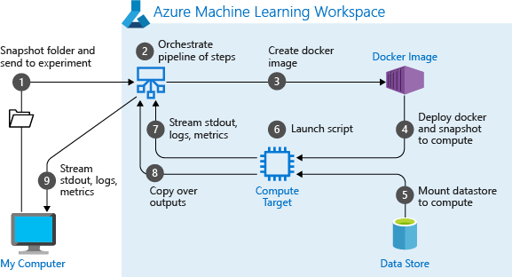
Preferred solution
Component Classification
Diagram what happens when you run a machine learning pipeline in Azure Machine Learning.
Notes:
When you first run a pipeline, Azure Machine Learning:
- Downloads the project snapshot to the compute target from the Blob storage associated with the workspace.
- Builds a Docker image corresponding to each step in the pipeline.
Downloads the docker image for each step to the compute target from the container registry.
- Mounts the datastore, if a DataReference object is specified in a step. If mount is not supported, the data is instead copied to the compute target.
- Runs the step in the compute target specified in the step definition.
- Creates artifacts, such as logs, stdout and stderr, metrics, and output specified by the step. These artifacts are then uploaded and kept in the user’s default datastore.

Slide 21
Preferred solution
Enabling DevOps for AI with MLOps
1. Building on the approach you suggested to Trey for machine learning pipelines, what would you propose they use to fold them into a bigger DevOps pipeline for continuous integration and delivery that would result in a new scoring web service being deployed whenever there was a change to the code supporting model training.
Trey should use Azure Pipelines, which is a service of Azure DevOps Services.
2. In your Azure Pipelines design, give an example of what would trigger the execution of the pipeline?
One example could be when a data scientist makes a change to the machine learning pipeline definition script and checks that script in to source control backed by an Azure DevOps Repo.
3. What type of Azure Pipeline would be triggered first in response (Build or Release)?
The first pipeline should be a Build pipeline.

Slide 22
Preferred solution
Enabling DevOps for AI with MLOps
4. What are the core steps in this first pipeline? What does the pipeline output?
The Build pipeline would need to perform the following steps:
- Create the Linux host VM that would execute the pipeline definition script.
- Create a new or get a reference to an existing Azure Machine Learning workspace
- Create a new or get a reference to an existing Azure Machine Learning compute cluster, and trigger a scale up if needed.
- Submit the machine learning pipeline for execution.
The outputs of this pipeline would be:
- A set of build artifacts.
- A trained model registered in the model registry of the workspace.
- A Docker image registered in the Container Registry.

Slide 23
Preferred solution
Enabling DevOps for AI with MLOps
5. After the first pipeline, what kind of Azure Pipeline would Trey define to deploy the scoring web service? What are the core steps in this pipeline? What does the pipeline output?
Trey should define a Release pipeline. This pipeline would perform the following steps:
- Create the Linux host VM that would execute the web service deployment script.
The outputs of this pipeline would be:
- A web service running in either Azure Container Instance or Azure Kubernetes Service.

Slide 24
Preferred solution
Enabling DevOps for AI with MLOps
6. How would Trey modify the aforementioned deployment pipeline to enforce that a manual sign-off is performed before the web service could be deployed into the production environment?
The release pipeline could begin with a pre-deployment approval configured at the entry point of a stage. An approval would need to be provided within the timeout specified or the deployment would be rejected. A notification, such as an email, can be sent to the approver defined for the approval step. Approvers can submit their approval using the Release summary page.
7. How could Trey configure their Azure Pipelines so as to avoid hardcoding credentials to access Azure resources?
They could create a Service Connection that would allow the Azure Pipeline to access a targeted Azure Subscription or a specific resource group within that Subscription.

Slide 25
Preferred solution
Monitoring in Production
1. How would you recommend Trey collect diagnostics of the scoring web service in production?
They should enable Application Insights integration.
They can do this either in code or by using the workspace via the Azure Portal.
In code, they accomplish this by using Azure Machine Learning SDK to retrieve a reference to the deployed service and then run `web_service.update(enable_app_insights=True)`.
In the Azure Portal, they would navigate to their workspace, select Deployments, select their web service, and then select Edit. Under the Advance Settings, they need only check `Enable AppInsights diagnostics`.

Slide 26
Preferred solution
Monitoring in Production
2. How can Trey collect the data input to the scoring web service and the outputs that result, such that they could monitor how the model is performing in production?
They would need to make a modification to their scoring script to include a reference to the `ModelDataCollector`.
Then they would create one instance of the ModelDataCollector to capture the input values and another to capture the output values within the `init` method of the scorings script.
They would use the `collect` method of each collector object in the `run` method to capture the desired data.
Additionally, they would need to update the web service deployment configuration.
They can do this in code by updating their configuration object that is used during deployment, such as `aks_config = AksWebservice.deploy_configuration(collect_model_data=True)`.
Alternately, in the Azure Portal, they would navigate to their workspace, select Deployments, select their web service, and then select Edit. Under the Advance Settings, they need only check `Enable Model data collection`.

Slide 27
Preferred objections handling
1. We are not clear about the benefits that using ONNX might bring to our current scenario and future scenario. Also, we are confused about the various choices that seem to be available like Python vs. ML.NET, or Keras/Tensorflow vs. PyTorch. We are concerned about making the wrong technological choices.
ONNX provides two potential benefits to Trey's scenario.
ONNX provides a common model format that can be run within a wide range of environments, without needing the libraries that were used to create the model. For example, if a model is created with Keras, they would need neither Keras nor TensorFlow to use the model for scoring. They would only need the ONNX Runtime. This enables the ONNX model to be used in web services, in .NET applications, on IoT devices and on mobile devices without additional effort.
Because ONNX effectively re-compiles a model when converting to the ONNX format, it may provide some optimizations that improve the scoring performance. In some tests, improvements of 2x on average in the time taken to inference were experienced.
Keras vs. Pytorch is the subject of much discussion in the community, however the guidance for selecting between Keras and PyTorch boils down to: Keras may be easier to start with and easier to build production grade models, while PyTorch has a steeper initial learning, as it is lower level than Keras, but it offers greater flexibility, faster inferencing and improved debugability in the balance. For a comprehensive comparison, see https://deepsense.ai/keras-or-pytorch/.
Finally, the discussion Python vs. ML.NET (C# actually) boils down to the language preferences of developers. Also, see the above-mentioned advantages of ONNX which can effectively bridge the worlds of Python and C#.

Slide 28
Preferred objections handling
2. It seems like data scientists deploy their models as web services from their own python scripts, where as our developers are accustomed to using Azure DevOps to deploy their web services. Can we really have one tool that provides us build and deployment pipelines irrespective of whether we are deploying a model or web application code? Also, can we use the same tool to have a unified approach for real-time and batch scoring scenarios?
Yes. Both of these scenarios are supported by Azure DevOps and Azure Pipelines. Furthermore, you can use the same combination to automate deployment and operations for both types of scoring scenarios (real-time and batch).

Slide 29
Preferred objections handling
3. Obviously, we can't just have new models automatically deployed into production. What kind of safeguards can we put in place? What kind of support does Azure Machine Learning service have for enterprise security?
You can create release pipelines that include pre-approvals that require a person to approve a release before it is deployed into production.
Azure Machine Learning service has a solid set of features supporting enterprise security including authentication for web service deployment, identity management and authorization, network security (including the use of virtual networks), data encryption, and monitoring. Standard, Azure AD-enabled, user and role management provides support for fine-grained control to Azure Machine Learning service resources. For a detailed overview of enterprise security features, see https://docs.microsoft.com/en-us/azure/machine-learning/service/concept-enterprise-security.

Slide 30
Preferred objections handling
4. In the future, we envision providing some of the trained models in devices that are embedded into the manufacturer's assembly lines. Will we need a completely different solution and process for that?
No. The integration between Azure Machine Learning and IoT Edge devices provides a solid foundation for such scenarios. Read more at https://docs.microsoft.com/en-us/azure/iot-edge/tutorial-deploy-machine-learning.
5. The business processes of our customers are subject to extensive scrutiny from auditors and regulators. Can we really have traceability through the entire process, including explaining the results produced? On the same note, will be aligned with the principles of responsible AI?
Azure DevOps and Azure Machine Learning service are providing excellent out of the box capabilities to support process traceability.
The AML Python SDK has support for model explainability (both global and local).
The context and the models developed by Trey Research are fully aligned with the core principles of responsible AI:
- Fairness
- Inclusiveness
- Reliability and safety
- Transparency
- Privacy and security
- Accountability
The details about Microsoft's approach to AI are available at https://www.microsoft.com/en-us/ai/our-approach-to-ai.

Slide 31
Preferred objections handling
6. We have heard Azure Machine Learning service supports automated machine learning. Can we incorporate automated ML in an end-to-end DevOps pipeline?
Automated machine learning in Azure Machine Learning service helps to simplify and expedite the process of producing a performant model. It does this by trying many combinations of best practice data preparation (automated pre-processing and featurization), algorithm selection and algorithm parameters (hyper-parameter tuning) while asking the user only for some relatively simple configuration information (such as the type of prediction problem, the input training data set, the feature to predict and the compute resources on which to experiment) to perform the job. Be aware though that automated ML currently only supports classic machine learning algorithms and not deep learning approaches.
Through the Python SDK, the automated ML capabilities can be fully integrated into DevOps pipelines.
7. Some of our team has worked with Azure Databricks (trained a few models in Spark MLlib), and they are confused by the overlap with Azure Machine Learning service. How should we be thinking about when to use which?
Consider using both. The best way to think about the relationship between Azure Databricks and Azure Machine Learning service is that Azure Databricks provides the tools for data engineers and data scientists to author their data and machine learning pipelines as well as the compute that powers these, and Azure Machine Learning service provides the platform that formalizes the modeling process by capturing data about training runs, versioning pipelines and models and assisting with the deployment of models as web services.

Slide 32
Customer quote
"Not only is Azure enabling faster machine learning and deep learning, but it is giving us powerful tools to manage the entire integration and deployment process that we can use across development and data science uniformly."
- Francine Fischer, CIO of Trey Research

